Slide 1
Phishing
Severin Kaderli
Notes:
Welcome

Slide 2
Overview
What is phishing?
Methods
Mitigation
Importance as IT professional
Questions

Slide 3

What is phishing?
Obtaining of sensitive information
Tricking of users
Evolution of social engineering
Notes:
Process of obtaining sensitive information of users
Done by tricking users to give them the information
It’s an evolution of social engineering, which is «phishing in real life»

Slide 4
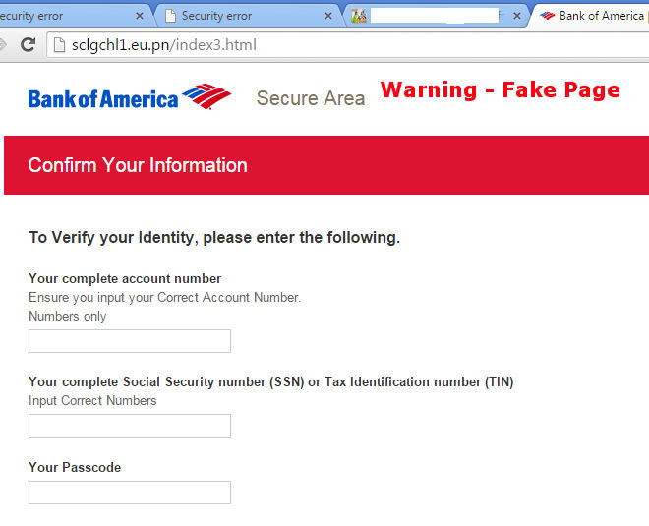
Methods - Basics
User inputs enters sensitive information
Copy of a website
Notes:
Basics are the users enters sensitive information in the wrong place
I.E. on an copy of a login site for your e-banking
Easily made
How does the user get on the wrong site?

Slide 5
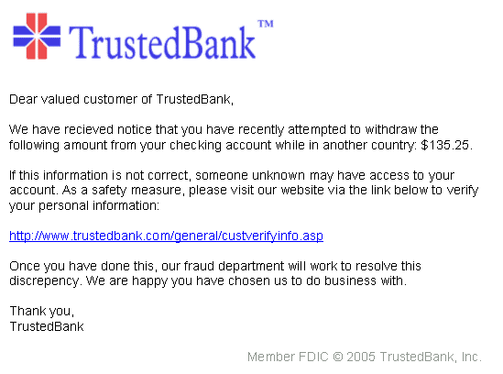
Methods – Email
Link in Email
Notes:
Link to dangerous site in mail
Resembles a real email

Slide 6
Methods – DNS spoofing
Changing DNS entries
Real link goes to wrong site
Notes:
Chaning DNS entries to redirect from real link to wrong site
Can happen with the help of malware

Slide 7
Methods - Typosquatting
Uses site name with typos
I.E. my-bank.com -> my-bnak.com
Notes:
Uses common typos to catch users

Slide 8
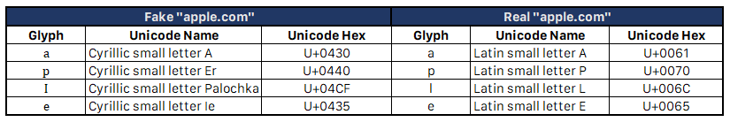
Methods – Homograph attack
URLs with same looking characters
Notes:
Uses urls which look like the original site
Different characters. Other alphabets, 0 instead of O

Slide 9
Mitigation
Look at the URL
Don’t click every link in email
Keep software up to date
Notes:
Always look at the url (https lock, real name)
Don’t believe everything in emails
Keep your software up to date (to fix security issues, browser helps detecting homograph attack)

Slide 10
Importance as IT professional
Phishing is one of the greatest attack vector
Teach users
Can ruin reputation of your company
Notes:
Phishing is one of the biggest attack vector
Teach users about the risks of phishing
If you fall for a phishing attack it can ruin the repuation of your company

Slide 11
Questions
Notes:
Any questions?

